Slide 1
Florida State University
Special Academic Program in Chemical
Engineering

Slide 2
Topics
FSU - Highlights
Special Academic Program Overview
Student Benefits
Program Support
Cost of Program
SAP Results
SAP in Chemical Engineering
Student Feedback
Eligibility and how to Apply
Graduate Studies at FSU
FSU Contacts

Slide 3
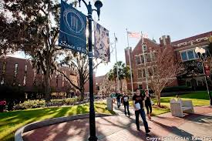
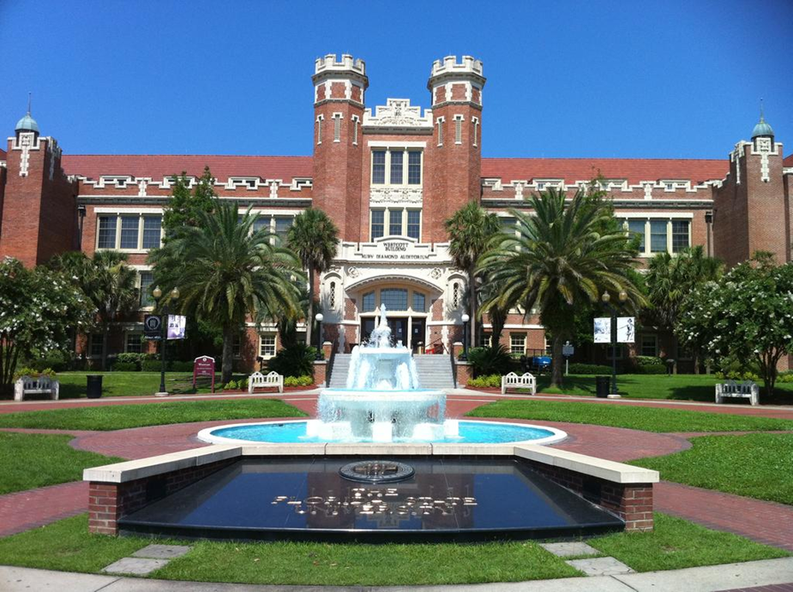
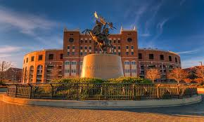
Florida State University
1 of 2 top public research universities in the State of Florida
4th "Best Value" public university in the US in 2012.¹
38th among Top Public Universities in the US.²
Home of the National High Magnetic Field Laboratory

Slide 4
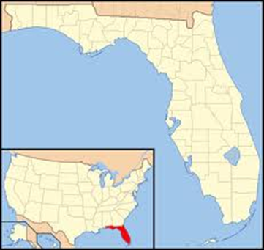
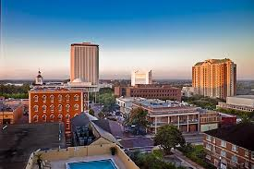
Florida State University
Other FSU Highlights
FSU leads Florida in 4 of 8 areas of external funding for the STEM disciplines (Science, Technology, Engineering and Math).
19th “Best Values in Public Colleges” for out-of-state students in 2015.³
Student population
41,000 students from 130 countries
Located in Tallahassee, the state capital
¹Princeton Review & USA Today; ²US News & World Report.³Kiplinger’s Personal Finance

Slide 5
Special Academic Programs (SAP)
3+1+1 program (Bachelor + Master program)
Year 1-3: Students take required courses at their home university, including program prerequisites.
Year 4: Students study at FSU for 2 semesters. Course credit transfers back and students receive a Bachelor degree from their home university.
Optional Year 5: Students may apply to FSU’s Master in Chemical Engineering program, and potentially graduate in 3 additional semesters (typically fall, spring, summer).

Slide 6
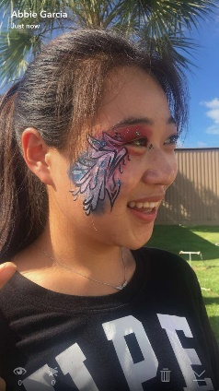
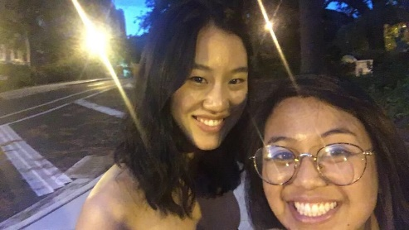
Special Academic Programs (SAP)
Student Benefits
Study with American and international students
Variety of teaching styles – lecture, small group instruction, labs, and practical training.
Get to know professors, the department, and the local area in advance, providing a seamless transition to graduate school.
Receive academic & non-academic support throughout the program.
Room & food included in
Program fee.

Slide 7
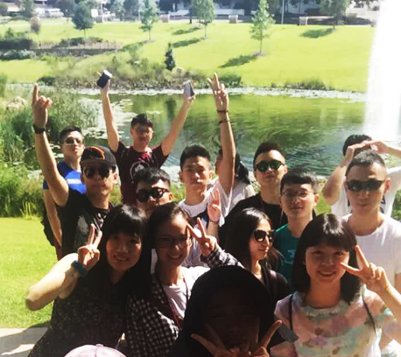
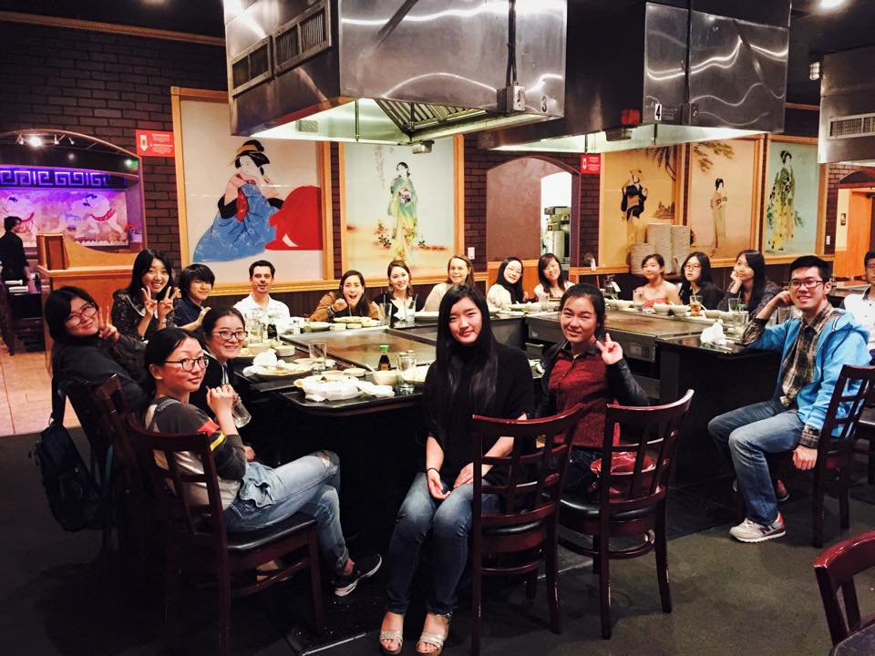
Program Support
Pre-arrival Support and Orientation
Help and support with applications & registration
Organize room and board
Airport pickup
Orientation to departments, campus & city
Ongoing Academic and Non-academic Support
Academic support: enrollment in classes, blackboard support, support for graduate school applications
Non-academic support: housing, immigration matters
Student peer mentor
Integration into campus activities
(sports, cultural and other events)
Regular local shopping

Slide 8
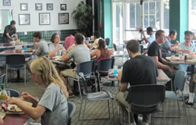
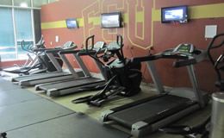
Cost of Program
Program Dates - August 2017-May 2018
Costs
Students pay approximately $30,000 program fee, includes: housing, meals during term, 27 FSU credits, program support, FSU ID card & fees.
Students also pay: SEVIS and visa application fees, airfare to Tallahassee, medical insurance meeting FSU requirements, textbooks, and personal costs and food during breaks.
Housing (included in Program fee)
Students live in a residence hall located next to FSU’s main campus.

Slide 9
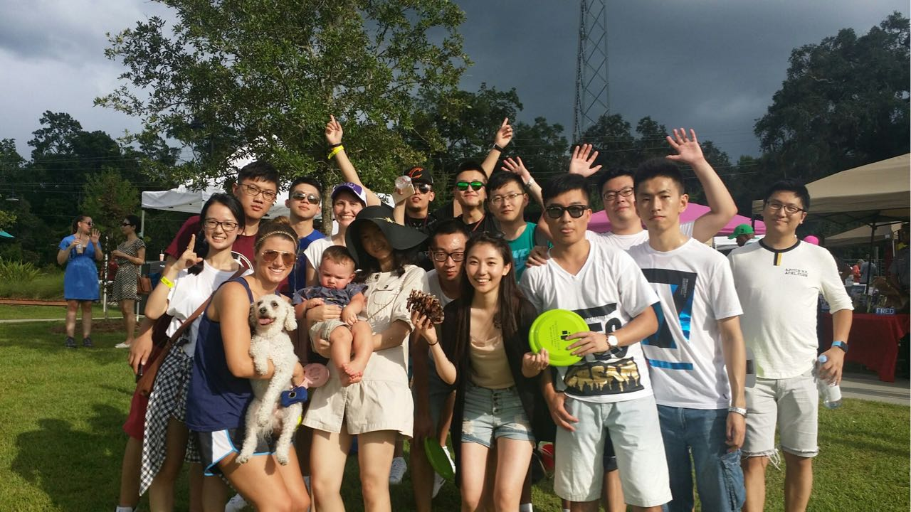
Special Academic Program Results
95% of SAP engineering participants applied for admission to a FSU Master degree program after completing their SAP program.
100% of SAP participants were accepted into the Master degree program at FSU.

Slide 10
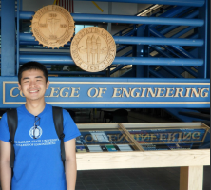
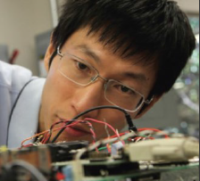
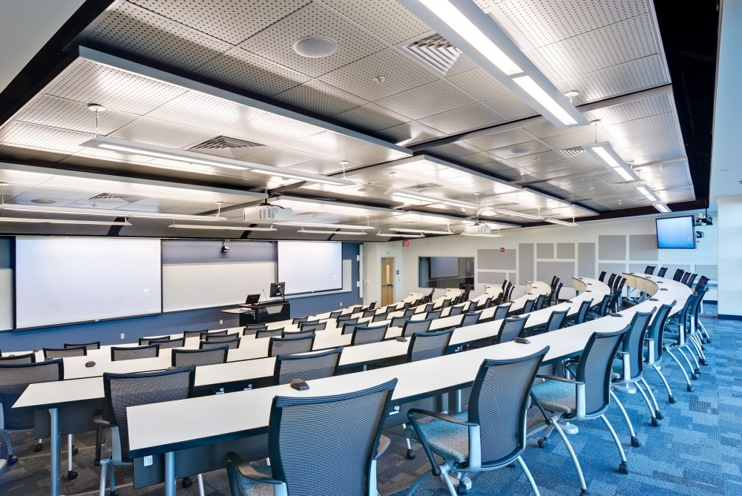
Chemical Engineering
Prerequisites – must be taken at home university
Such as: Mass & Energy Balances I & II, Process Analysis & Design, Transport Phenomena I, Kinetics & Reactor Design, Principles of Chemical Engineering I & II, Chemical Reaction Engineering, Fundamental Chemistry
Speak to your institutional contact to find out the prerequisites for your university
Engineering classes at FSU – up to 27 credit hours
If fewer than 27 credit hours are needed for the student to graduate with a Bachelor degree, please notify FSU.
Chemical Engineering Computations
Chemical Engineering Process Design I & II
Process Control & Lab
Advanced Transport Phenomena II
3 Undergraduate or Graduate technical courses

Slide 11
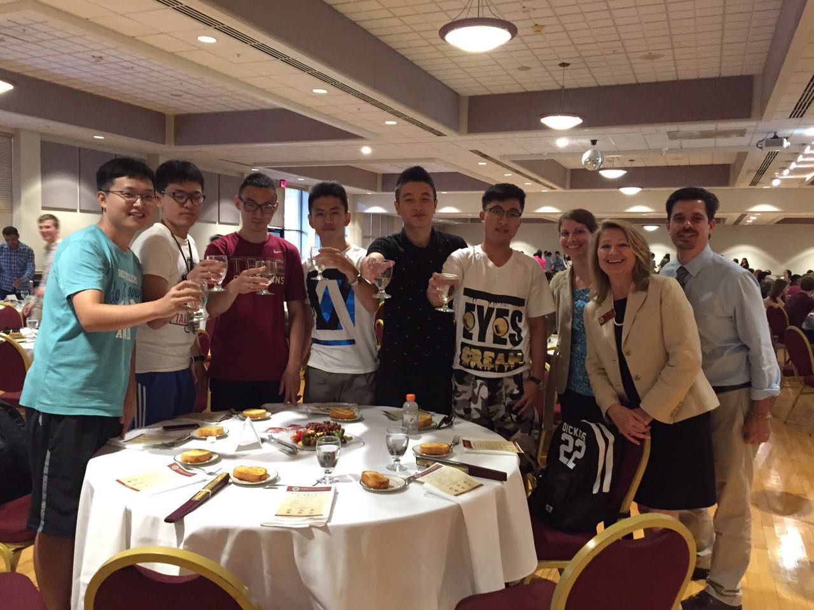
Student Feedback
“TOEFL score increased by 20 points during the SAP program”
“This special program is challenging cause it is an accelerated process, but I would never have known my potential without participating it. By the way, I really enjoy small classes here.”
“This program gave me the opportunity to enhance my oral English fluency and prepare for my graduate career… Opting for this program is one of the hallmarks of my learning experience.”

Slide 12
Eligibility and Application Process
Eligibility Target
GPA: 3.0
English proficiency: iBT TOEFL 80/IELTS 6.5
Optional: letters of recommendation from instructors, personal essay
Students scoring below the target GPA or English proficiency scores may be considered on a space available basis and on the recommendation of their instructors.
SAP Application Deadlines
April 21, 2017 – deadline to apply. Must submit English proficiency scores, transcript in English, & application forms
April 24-30, 2017 – FSU will evaluate applications
May 1, 2017 – Notification of admission decisions
May 12, 2017 – Last day to pay full program fee to reserve a place on the program

Slide 13
Graduate Studies at FSU
Up to 12 credit hours taken during the 3+1+1 can count towards the Master degree at FSU depending on the level of courses taken (9 credits typically).
Students may apply for financial assistance but should plan to be self-supported.
Estimated tuition cost – $20,000-$30,000 depending on number of credits transferred ($25,000 typically).
Cost of living estimate $15,000
Graduate Admissions
Official transcripts
Qualifying GRE percentiles: 48% verbal & 75% quantitative
GPA: 3.0 (B average or above)
TOEFL 80/IELTS 6.5
Application Deadline
March 1
*Students will receive support on applications to FSU Graduate Programs.

Slide 14
Advice for Interested Students
Plan ahead!
Begin studying English immediately.
Register & take the TOEFL/IELTS early; there is a 3-month wait time in China.
Register for the exam – September-October.
Take the exam – November-early December.
Register your interest well in advance!
Speak to your professors about the opportunity.
Contact the Special Programs team at FSU.
Apply by the deadline!
Even if you are not sure you will qualify – APPLY. FSU will review your application.

Slide 15
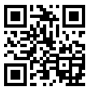
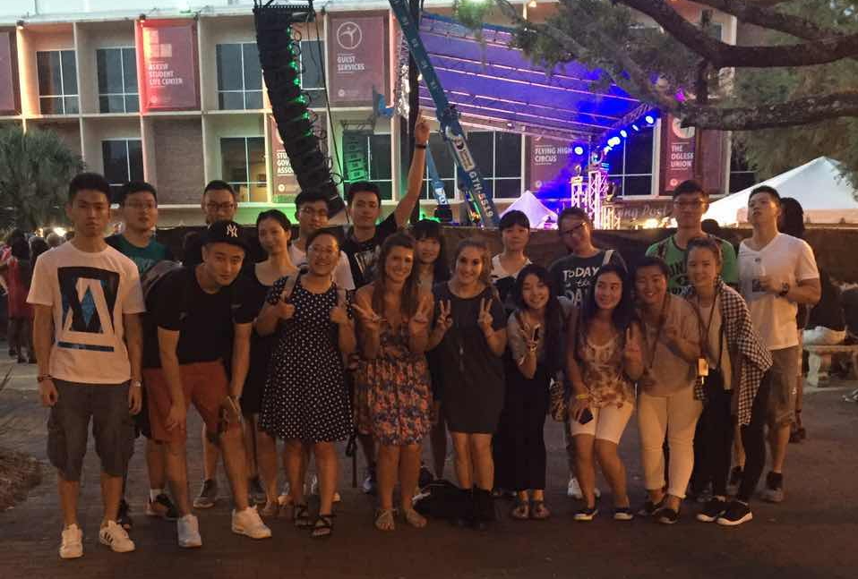
FSU Contacts
Please see the 3+1+1 program website at:
https://cge.fsu.edu/sap/prgms_chemical.htm
For more about the Department of Engineering at FSU, please see: eng.fsu.edu/cbe/

Slide 16
Thank You!

