Slide 1
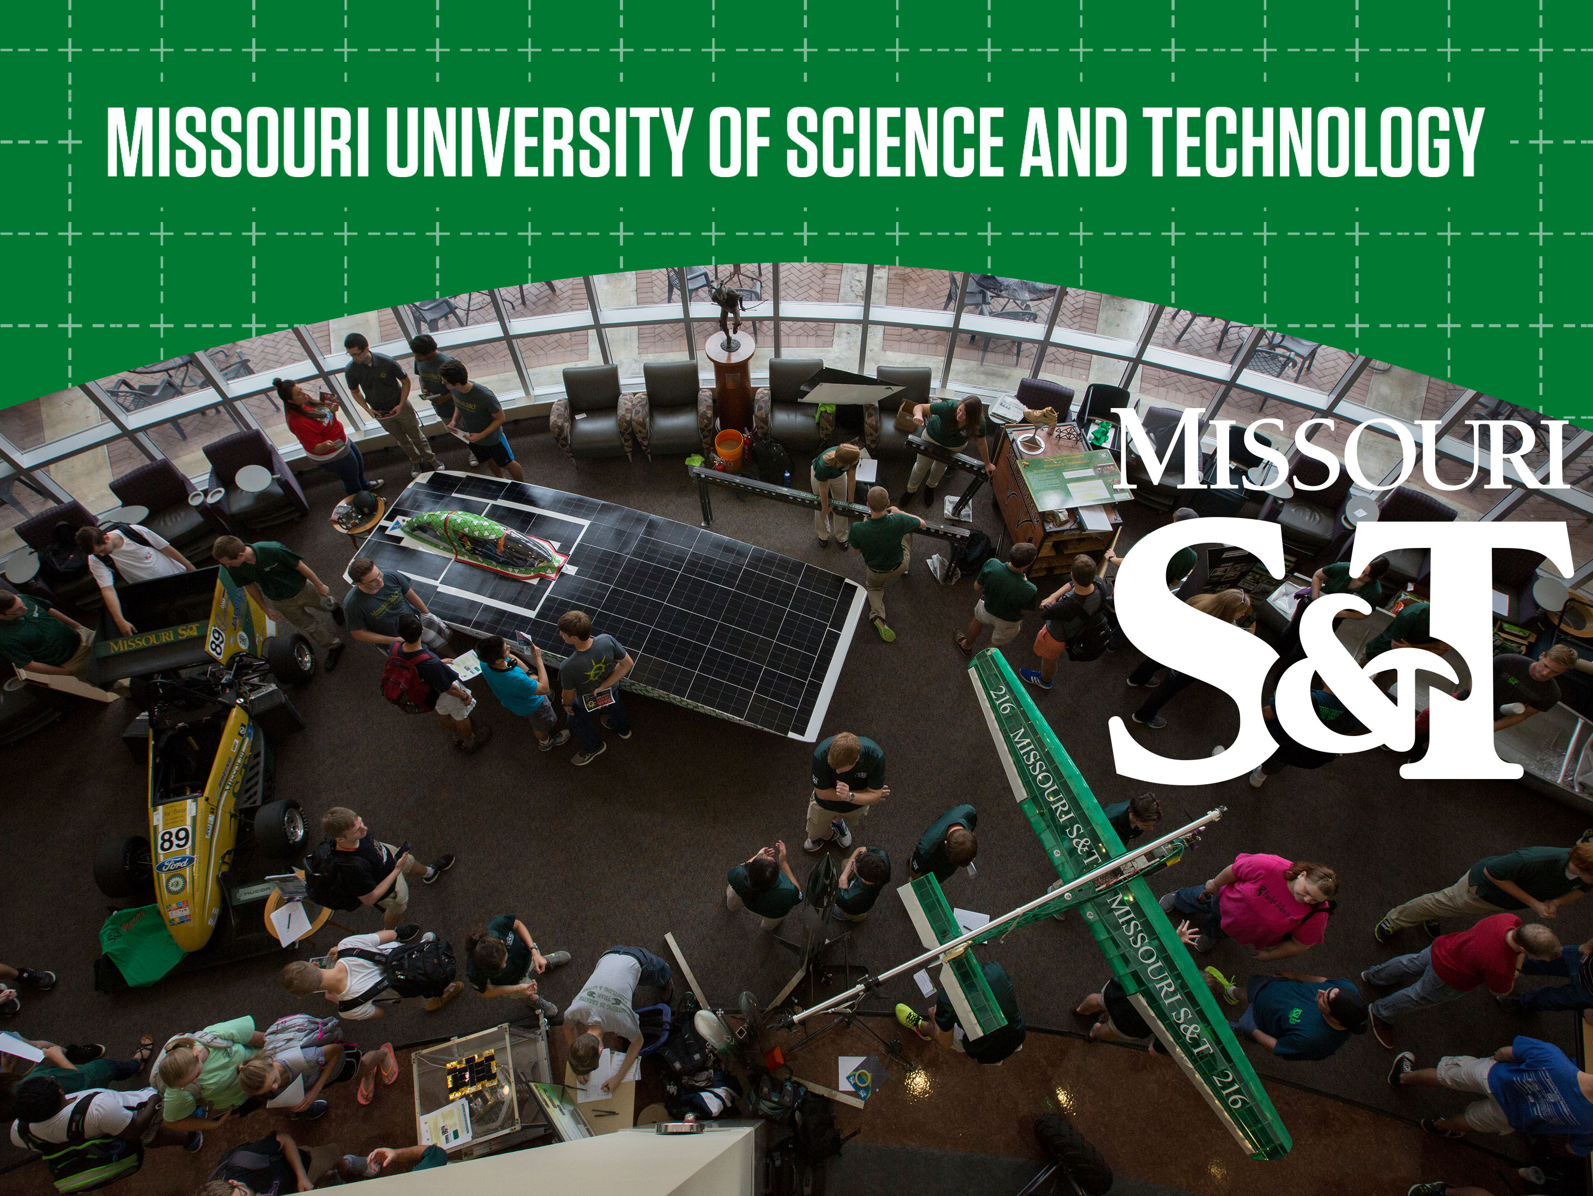

Slide 2
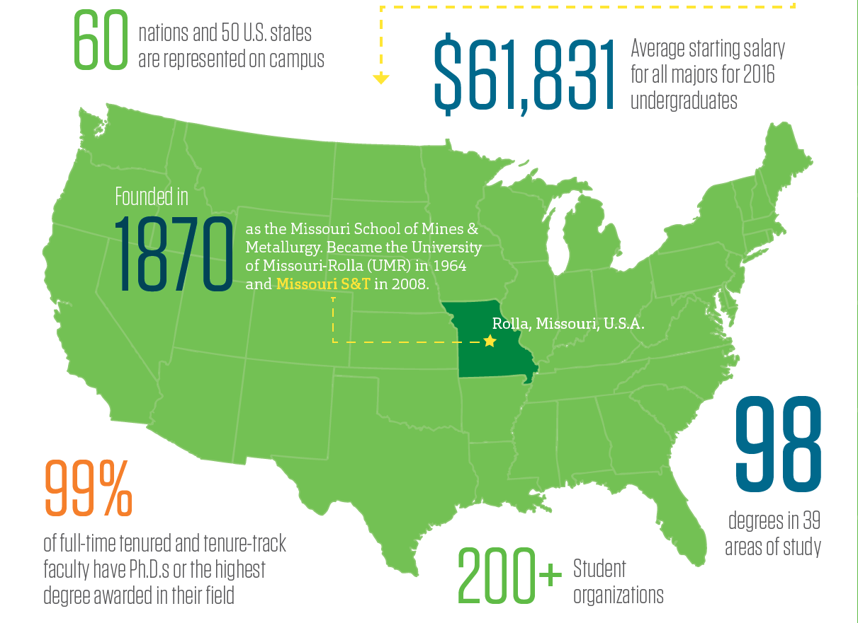

Slide 3
Mission:
Missouri S&T integrates education, research and application to
create and convey knowledge that serves our state and helps
solve the world great challenges.
University History
1870: Founded as Missouri School of Mines and Metallurgy
(MSM)
1964: University of Missouri-Rolla (UMR)
expanded curriculum and research mission
2008: Missouri University of Science and Technology
The “Missouri S&T” name emphasizes our STEM
(science, technology, engineering, and mathematics)
focused mission

Slide 4
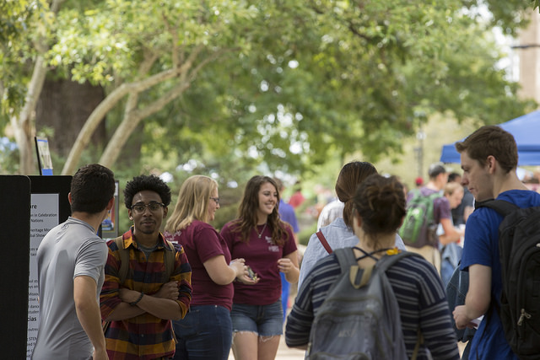
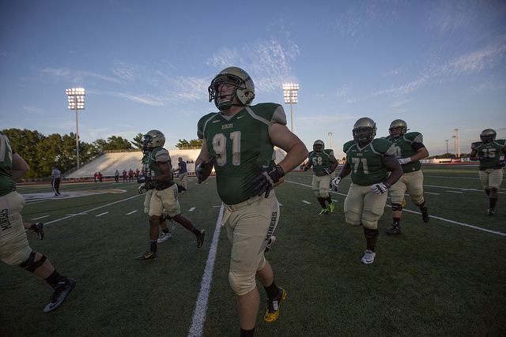
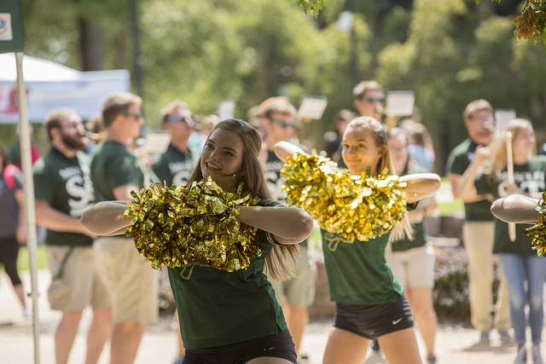
One of America’s top public research universities
Top 100 U.S. university (QS World University Rankings, 2017)
3rd Best Engineering College (USAToday, August 2016)
No. 2 vale-added public university (Brookings Institute, April 2015)
No. 15 “smartest public college” in the U.S. (Business Insider, September 2015)

Slide 5
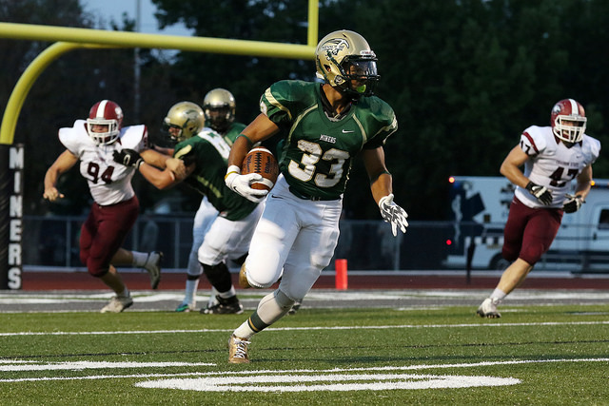
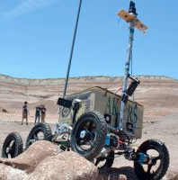
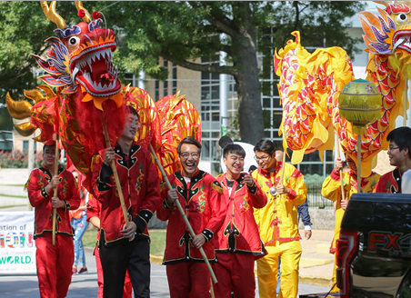
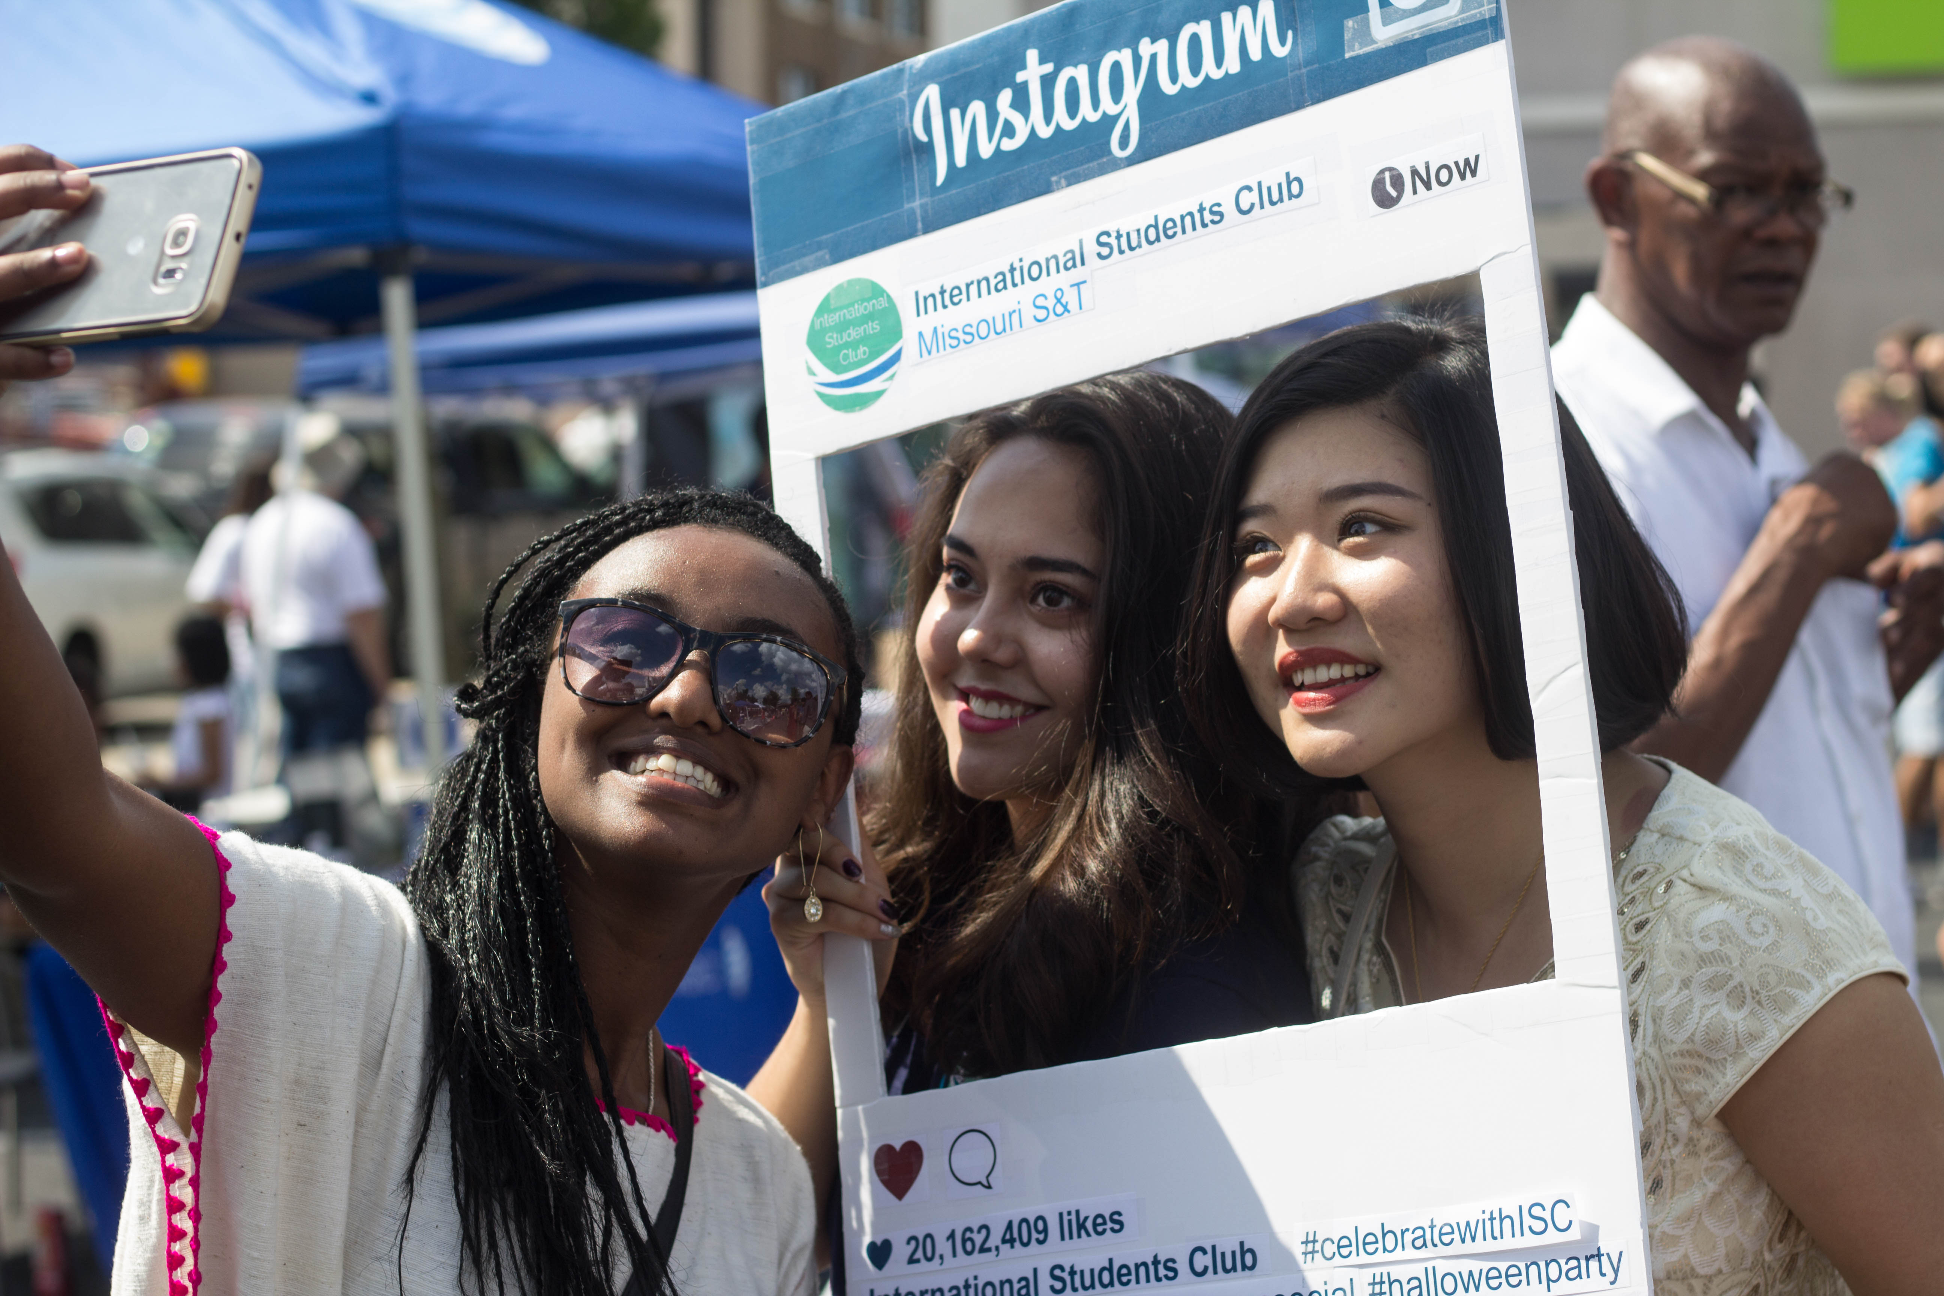
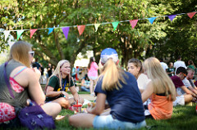
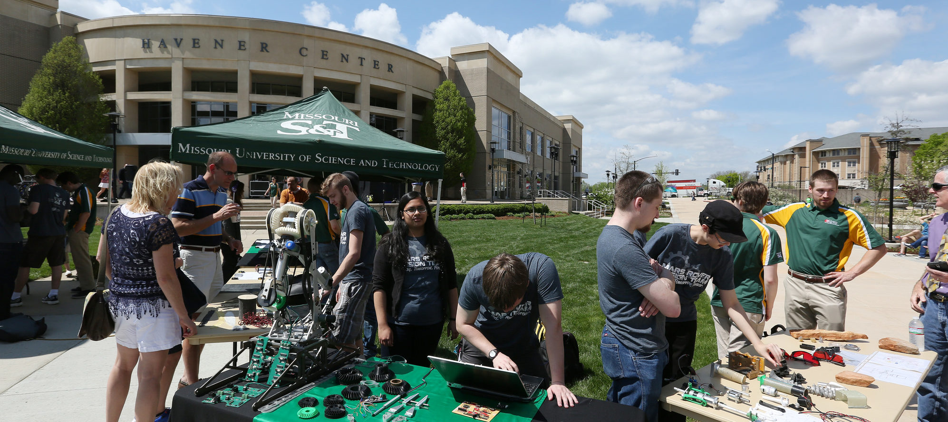
200+ Student Organizations
Council of Graduate Students
Chinese Student and Scholar Association (CSSA)
Intercultural
Academic & Departmental
Faith Based & Spiritual
Honorary & Professional
Design Teams
Radio, Newspaper,
and Other Media
Intramural Sports
Service & Social

Slide 6
Department of Business & Information Technology
Each of our four degrees are AACSB Accredited
B.S. Business & Management Systems
B.S. Information Science & Technology
Master of Business Administration (MBA)
M.S. Information Science & Technology
Less than 5% of the world’s 13,000 business programs have earned AACSB accreditation
#1 MBA graduates with lowest debt (Yahoo Finance, 2016)
#2 Best Online Big Data Programs (Value Colleges, 2016)
#10 in MBA in Supply Chain (Online MBA Today, 2016)

Slide 7
2+2 and 3+2 Agreements
2+2: students spend first 2 years in China, then 3rd and 4th year in Missouri S&T
Student will receive a Bachelor’s degree from China and a Bachelor’s degree from Missouri S&T
GPA-2.5; IELTS-6.0 or TOEFL-79
3+2: students spend first 3 years in China, then 4th & 5th year in Missouri S&T
4th year: dual enroll in some graduate courses
5th year: completion of Master’s degree
Student will receive a Bachelor’s degree in China and a Master’s degree from Missouri S&T
GPA-2.8; IELTS-6.0 or TOEFL-79

Slide 8
Or You Can Apply for Our Master’s Programs Directly
Master of Business Administration (MBA)
36 credit hours (12 courses)
Duration: 1.5 – 2 years (only 1 year for 3+2 students)
GPA-3.0; IELTS-6.5 or TOEFL-88; GMAT-550
13 Graduate Certificates, e.g. Financial Technology, Digital Supply Chain, Business Project Management
M.S. Information Science & Technology
30 credit hours (10 courses)
Duration: 1 – 1.5 years (only 0.5 – 1 year for 3+2 students)
GPA-3.0; IELTS-6.5 or TOEFL-88; GRE(V)-144, GRE(Q)-148, GRE(AW)-3.5
13 Graduate Certificates, e.g. AI & Machine Learning, Big Data, Cybersecurity

Slide 9
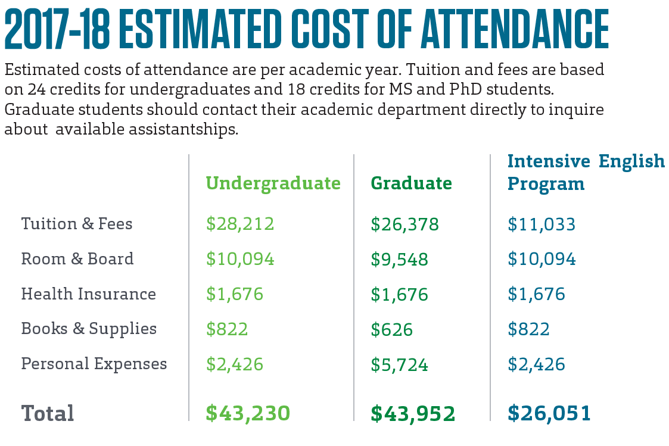

Slide 10
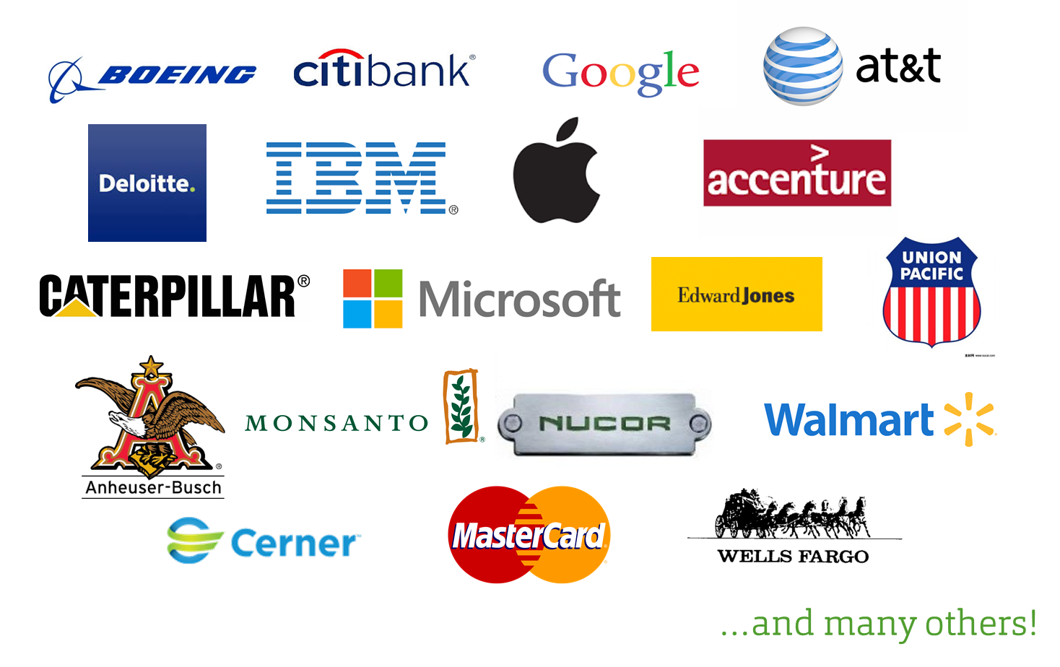
Missouri S&T Career Fairs and Top Employers

Slide 11
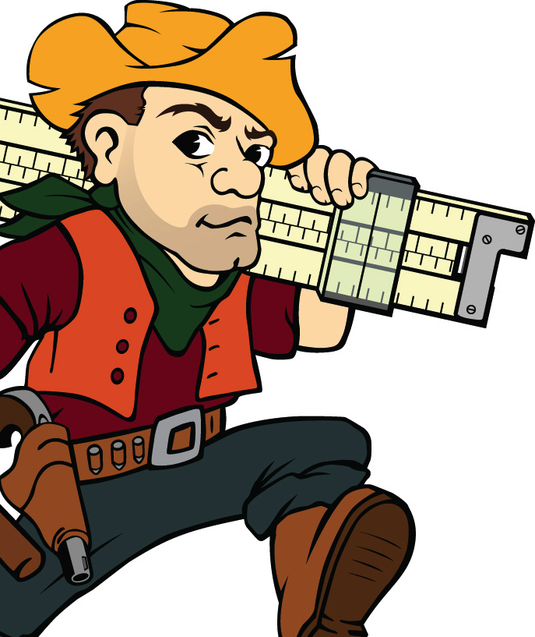
We’re Here To Help
Ms. Tracy Zou (可中文交流)
Student Support Specialist
Department of Business and Information Technology
Missouri S&T
tracyzou@mst.edu
bit.mst.edu

